Slide 1
Detection Error Probability Maximization for Disguised Full-Duplex Covert Communications
Refat Khan
Advised by Professor Jihwan Moon
Cognitive Communication System Lab
Department of Mobile Convergence Engineering
Hanbat National University
May 27, 2024

Slide 2
Outline
.
Biography
Motivation And Background
System Model
Abstract

Slide 3
Biography
Education
Experience
Year | Degree | Major / Minor
2017-2021 | B.Eng., University of Information Technology and Science | Computer Science and Engineering
2022-2024 | M.Sc., Hanbat National University | Mobile Convergence Engineering
Year | Organization | Position
2022.04 – 2022.06 | Nazdaq IT | Trainee Engineer-Network operations center
2020. 01 – 2022. 03 | Sp Wave | Junior web developer

Slide 4
Motivation and Background
Securing Wireless Communication
Wireless technology
Transforms lives but cyberattacks pose a threat.
To cope with this, cryptography has widely been adopted.
The perspective of physical layer security
Yet, cryptography has limitations: complex key generation, powerful eavesdropper
To examine the possibility of utilizing physical layer security
Security Threats:
Opponents can conduct traffic analysis by collecting metadata during transmission.
Vulnerabilities include capturing source and destination addresses, request-response frequency, etc.
An approach of secure communications: Covert Communication
Need for Covert Communications
Transmit data in a manner that avoids detection or suspicion
Combining cryptography and physical layer security can prevent eavesdropping, but covert communications are necessary to counter traffic analysis threats

Slide 5
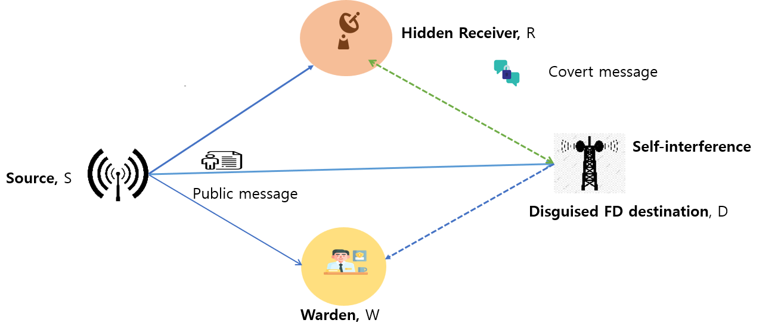
System Model
Covert Communication System Setup
Source node (S) transmitting a public message to the destination node (D)
Covert transmission conducted by the seemingly receive-only destination node (D)
Covert signal transmitted to the hidden receiver (R) using an unseen antenna
Full-duplex (FD) communication implemented, allowing simultaneous transmission and reception
Warden node (W) monitoring for suspicious communications

Slide 6
Abstract
Research Focus:
Reliable covert communications with disguised FD node.
FD node: Appears half-duplex receive-only, transmits covertly.
Challenges:
Detection by a warden node.
Methodology:
Studied detection error probability (DEP).
Derived optimal transmit power for FD node.
Key Findings:
Optimal transmit power maximizes worst-case DEP.
Ensures reliability of covert rate.
Results:
Numerical validation of proposed solution.
Impact of system parameters on DEP.
Conclusion:
Guidance for secure communication design. Future research directions.

Slide 7
Thank you.

